Slide 1
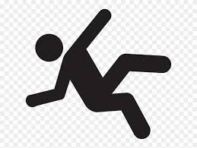
The Dangers of Falling
Presentation by Mark Quinlan, Resident Services Administrator
Barclay Friends

Slide 2
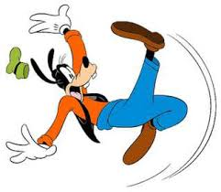
Every second of every day, an older adult (age 65+) suffers a fall in the U.S.—making falls the leading cause of injury and injury death in this age group. One out of four older adults will fall each year in the United States, making falls a public health concern, particularly among the aging population.

Slide 3
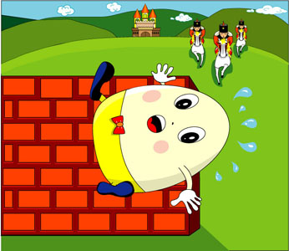
About 36 million older adults fall
each year—resulting in more than
32,000 deaths.
One Fall Changed it All

Slide 4
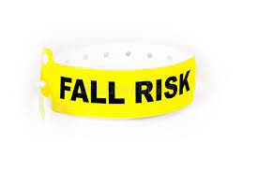
OUCH!
About 3 million older adults are
treated in emergency departments
for a fall injury.

Slide 5
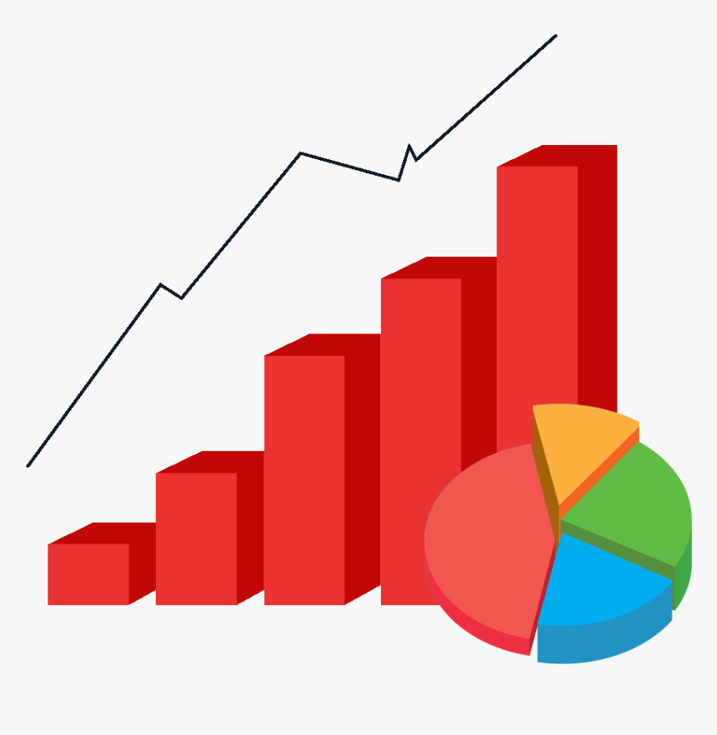
One out of every five falls causes an injury, such as broken bones or a head injury.
Each year at least 300,000 older people are hospitalized for hip fractures.

Slide 6
True or False ?
More falls occur in a persons own home?
There are more falls among the elderly while living in nursing homes?
Falls while out in the community are quite rare?

Slide 8
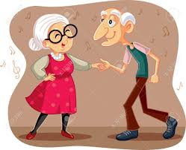
It Can’t Happen to Me
Falling down the stairs
Carrying a large load, not able to see steps, not using handrail
Falling up the stairs
Rushing trying to take steps two at a time
Falling while hiking
Hiking stick was not strong enough to hold me
Falling while biking
Traveling to fast down hill
Falling while sitting
Chair legs broke
Falling while knitting
This just rhymed ☺

Slide 9
Falls within a Health Care Setting
Cognitive Decline (dementia)
New surroundings; New people, New problems
Failure to ask for assistance
Not using the call bell system
Weakness, unsteady gait
Post surgery
Not accepting changes in condition
I thought I could do it
Not familiar with new equipment
Power recliners

Slide 12
QUESTIONS?

